Slide 1
Introduction to DNA-Seq and Variant Calling
Mariam Quiñones, PhD

Slide 2

Today’s Instructor
Bioinformatics and Computational Biosciences Branch (BCBB), NIAID
National Institutes of Health, Bethesda, MD USA.
Contact our team via email:
Email: ace@icermali.org
Listserv: ACE-GLOBAL-ANNOUNCE@list.nih.gov
Instructor: mariam.quinones@nih.gov
Dr. Mariam Quiñones,
Ph.D. in Molecular Microbiology
Ongoing Computational Biology projects:
16S microbiome
Ion Torrent Zika virus genome assembly

Slide 3
Overview
Relevant technology concepts
Introduction to genomic variant studies
WGS or Exomes
Step by step workflow for variant calling using GATK
Acknowledgement: Some of the slides included here were taken or adapted from materials created by other BCBB team members (Andrew Oler and Celine Hong). Thank you BCBB!

Slide 4
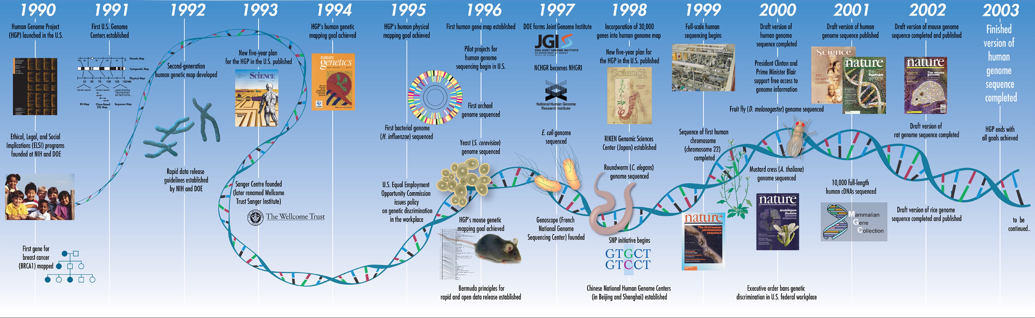
Important developments in studying genomic variations: First the Human Genome Project
Important developments in studying genomic variations: Timeline to Human Genome Project
https://www.mun.ca/biology/scarr/Human_Genome_Project_timeline.html

Slide 5

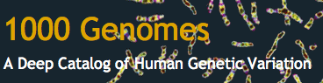
Genomic variations have been studied in large populations studies
Project that started on 2002 with the goal of describing patterns of human genetic variation and create a haplotype map using SNPs present in at least 1% of the population, which were deposited in dbSNPs.
1000 Genomes
Started in 2008 with a goal of using at least 1000 individuals (about 2,500 samples at 4X coverage), interrogate 1000 gene regions in 900 samples (exome analysis), find most genetic variants with allele frequencies above 1% and to a 0.1% if in coding regions as well as Indels and structural variants
Make data available to the public ftp://ftp-trace.ncbi.nih.gov/1000genomes/ftp/
or via Amazon Cloud http://s3.amazonaws.com/1000genomes
Notes:
HapMap
Project that started on 2002 with the goal of describing patterns of human genetic variation and create a haplotype map using SNPs present in at least 1% of the population, which were deposited in dbSNPs.
It used 269 individuals.
Haplotypes – adjacent SNPs that are inherited together
So far, project researchers have sequenced the genomes of 1,092 people from 14 populations in Europe, East Asia, sub-Saharan Africa and the Americas. Ultimately, they will study more than 2,500 individuals from 26 populations.

Slide 6

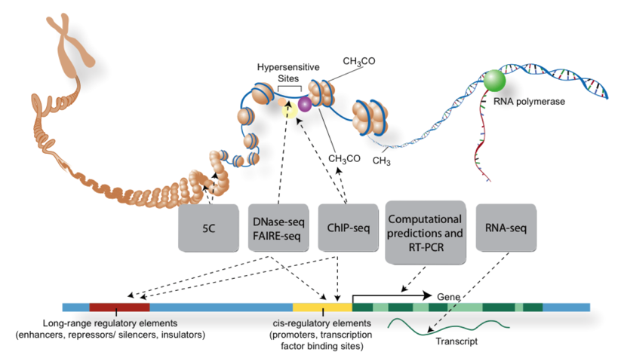
Variants are not only found in coding sequences
Main Goal:
Find all functional elements in the genome
Notes:
De novo mutations are not necessarily causal
Structural variants
CNV

Slide 7
There are many types of variants
http://www.labspaces.net/blog/1627/When_Whole_Genome_Sequencing_Doesn___t_Give_Us_the_Whole_Genome
Notes:
Pros for Exome-seq
Exoms represent 1% of the genome, and cost one tenth the cost for whole genome sequencing but the gap in cost is getting smaller
Deeper coverage (~60x), which allows finding more variants with greater confidence.
Most of known causal variants of Mendelian disorders have been found in exons.
Powerful diagnostics tool
Pros for WGS
With paired-end reads and libraries of various insert sizes, structural variations or chromosomal rearrangements can be detected
It doesn’t present the problem of “missing exons” due to failure in capture
Applications of exome-seq:
Characterization of tumor specific variants
Search for variants in known causative genes of Mendelian disorders by custom capture of target genes in multiple samples
Identify causative genes in hereditary disorders from whole exome analysis
Identify candidate genes for complex disorders such as autism by sequencing the exome of parent-child trios.

Slide 8
Overview of next-generation sequencing processing for variant analysis
Sequence
Align reads/mapping
Variant calling
Annotate
Downstream analysis
Quality control

Slide 9
Sequencers
Machine | Cost | methods | Throughput per run | Read length | Error rate
Illumina MiSeq | $128K | Small genomes, targeted gene | 1.5-2Gb | 2X300 | 0.8%
Ion Torrent | $80K | Small genomes, targeted gene | 1Gb | 400 | 1.71%
Illumina NextSeq | $250K | Exomes/transcriptome | 120Gb | 2x150 | 0.8%
Illumina HiSeq | $654K | Genomes/exomes/transcriptomics | 600Gb | 2X150 | 0.76%
Illumina X Ten | $10 Mil. | Genomes | 1.6Tb | 2x150 | 0.5%
PacBio | $695K | Genomes | 100Mb | 15K | 12.86%

Slide 10
Next-generation sequencing overview
 | Exomes (ES/WES) | Genomes (GS/WGS)
Cost | ~$1000 | ~$2000 (~$1000 with HiSeq X Ten)
Size of bam files | ~10 Gb | ~200 Gb
DNA | Targeted and captured | Sheared DNA
What you can get | Most coding regions (+UTR) | coding and non-coding
Variants that can be examined | SNVs, indels (CNVs) | SNVs, indels, CNVs, structural variations

Slide 11

Processing reads for Variant Analysis
Trimming:
Unless quality of read data is poor, low quality end trimming of short reads (e.g. Illumina) prior to mapping is usually not required.
If adapters are present in a high number of reads, these could be trimmed to improve mapping.
Recommended tools: Prinseq, Btrim64, FastQC
Marking duplicates:
It is not required to remove duplicate reads prior to mapping but instead it is recommended to mark duplicates after the alignment.
Recommended tool: Picard.
A library that is composed mainly of PCR duplicates could produce inaccurate variant calling.
http://www.biomedcentral.com/1471-2164/13/S8/S8
Clip: http://bestclipartblog.com

Slide 12
Overview of next-generation sequencing processing for variant analysis
Sequence
Align reads/mapping
Variant calling
Annotate
Downstream analysis
Quality control

Slide 13
Variant analysis can be done using the entire genome (WGS) or only coding sequences (exome)
Whole Genome
Exome-Seq
Useful for identifying SNPs but also structural variants in any genomic region
It is routinely done when studying genomes from bacteria or viruses
Interrogates variants in specific genomic regions, usually coding sequences.
Cheaper and provides high coverage
Notes:
Pros for Exome-seq
Exoms represent 1% of the genome, and cost one tenth the cost for whole genome sequencing but the gap in cost is getting smaller
Deeper coverage (~60x), which allows finding more variants with greater confidence.
Most of known causal variants of Mendelian disorders have been found in exons.
Powerful diagnostics tool
Pros for WGS
With paired-end reads and libraries of various insert sizes, structural variations or chromosomal rearrangements can be detected
It doesn’t present the problem of “missing exons” due to failure in capture
Applications of exome-seq:
Characterization of tumor specific variants
Search for variants in known causative genes of Mendelian disorders by custom capture of target genes in multiple samples
Identify causative genes in hereditary disorders from whole exome analysis
Identify candidate genes for complex disorders such as autism by sequencing the exome of parent-child trios.

Slide 14
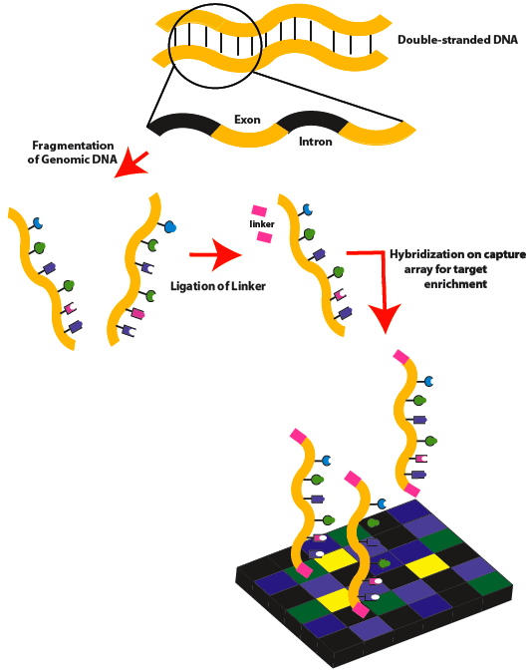
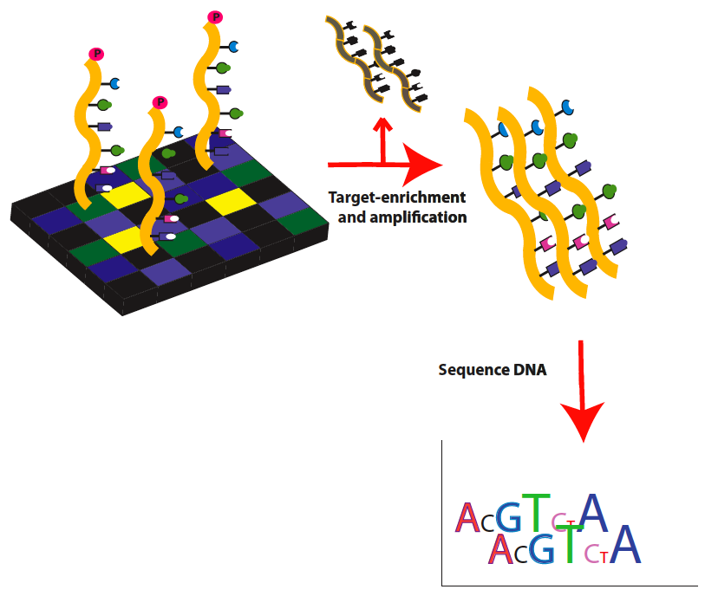
Exome sequencing overview
Ann https://en.wikipedia.org/wiki/Exome_sequencing#/media/File:Exome_Sequencing_workflow_1b.png. 2012 Jan; 71(1):5-14
Notes:
Part 1. Double-stranded genomic DNA is fragmented by sonication. Linkers are then attached to the DNA fragments, which are then hybridized to a capture microarray designed to target only the exons.
Part 2. Target exons are enriched, eluted and then amplified by ligation-mediated PCR. Amplified target DNA is then ready for high-throughput sequencing.

Slide 15
Partial list of capture enrichment kits
Manufacturer | Kits | Regions targeted | Bases covered
Illumina | Nextera Rapid capture | Exons + UTRs+ miRNA | 62 Mb
Nimblegen | SeqCap EZ Exome | Exons + UTR | 96 Mb
 | SeqCap EZMedExome | Disease-associated regions | 47 Mb
Agilent | SureSelect Human All Exon V6 | Exons+UTRs | 60Mb
 | Clinical Research Exome | Disease-relevant targets | 51Mb

Slide 16
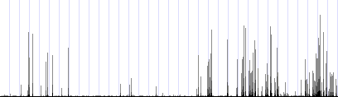
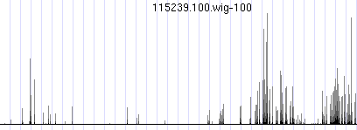
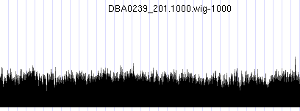
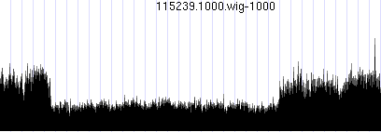
How exomes and genomes look
Genome has even coverage
Even a deletion is observed by eye
WT
Deletion
ES
GS
Notes:
-finding CNVs from exome is an additional information,

Slide 17
All about exomes
What is exome?
Sequencing targeted exonic regions
~2% of genome
Important to know
You will NOT get a whole exome!
Not all exons in all genes are captured!
Important to know the negative results vs no data
Coverage will vary in targets

Slide 18
What to know about your data
What is the sequence depth?
The depth your sequence
10x, 30x, 50x, 100x
Read length
How long is your read length?
What software was used to align?
Which reference was used?
Which capture kit was used? What is covered?
What variant calling was used to call variants?

Slide 19
Files and tools used for SNPs and Small INDELs
File type | Origin
FASTQ | Raw reads from sequencer
SAM BAM | Sequence Alignment/Map Binary version of SAM
gVCF/VCF | Variant call format
Tool | Purpose
BWA mem | Read alignment to reference
Picard | Mark duplicates
GATK (Haplotype caller) | QC/variant calling
Samtools | Sort sam/bam, convert sam<->bam

Slide 20
How to identify structural variants?
Try using tools which leverage information on read pairs or depth.
FUSORSV
1- Read Pair – use pair ends.
GASVPro (Sindi 2012), BreakDancer (Chen 2009)
2- Read depth – CNVnator (Abyzov, 2010)
3- Split read – PinDEL (Ye 2009)
4- Denovo assembly
Notes:
Hydra pipeline (Quinlan 2010), BreakDancer (Chen 2009), PEMer (Korbel 2009)
CNVnator (Abyzov, 2010)

Slide 21
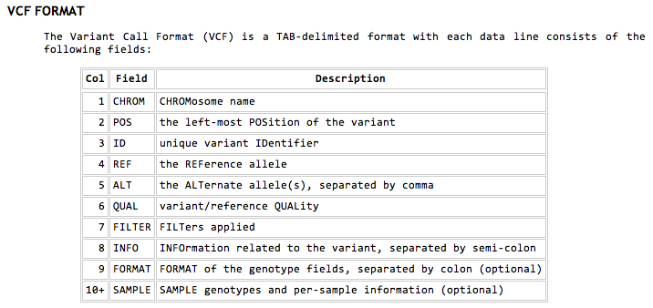
VCF format (version 4.3)
Format used to report information about a position in the genome
Use by 1000 genomes to report all variants

Slide 22
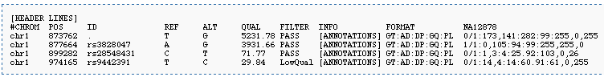
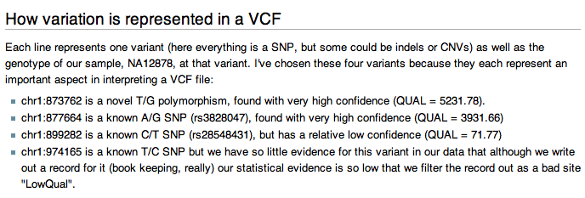
VCF format
See http://samtools.github.io/hts-specs/VCFv4.3.pdf

Slide 23
Popular tools for mapping, variant calling and annotation
Task | Popular tools
Align reads/mapping | BWA-mem Novoalign Isaac
Variant calling | GATK (Broad) Platypus (Wellcome Trust) Starling (Illumina)
Annotating variants | AnnoVar VEP SnpEff Gemini

Slide 24
Commonly used sources for reference genomes and annotations
Task | Popular source
Control population frequency | ExAC 1000GP ESP
Annotation | RefSeq Ensemble UCSC genes GENCODE
Visualization | UCSC genome browser IGV
Clinical relevance | HGMD OMIM CGD ClinVar
Variants and effect on gene expression | GTEX

Slide 25
Overview of next-generation sequencing processing for variant analysis
Sequence
Align reads/mapping
Variant calling
Annotate
Downstream analysis
Quality control

Slide 26

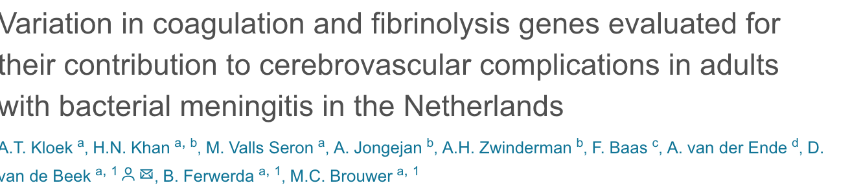

Example of variant calling with GATK
Sequencing: Solid 5500xl sequencer (Life technologies)
Mapping: Alignment to GRch37/HG19 reference genome using the Lifescope aligner (version 2.5.1, Applied Biosystems).
Preprocessing and QC: Reads were realigned, recalibrated and called using GATK HaplotypeCaller (version 3.3-0). Variants were filtered on minimal mapping quality score ≥30, minimal read depth of 20, allele balance between 0.2 and 0.8 for heterozygotes, >90 for homozygotes and genotype quality score of 99.
Additional QC and Filtering: All samples were combined and converted to PLINK format.¹⁸ Final QC was performed to exclude related individuals and samples with non-European ancestry based on a previous multidimensional scaling test.¹⁹ Markers with a missingness of 5% and Hardy-Weinberg equilibrium (HWE) p-value of < 1.0⁻⁵ were excluded from the analysis. For the regression analysis only markers with minor allele frequency (MAF) ≥ 0.01 were included.

Slide 27
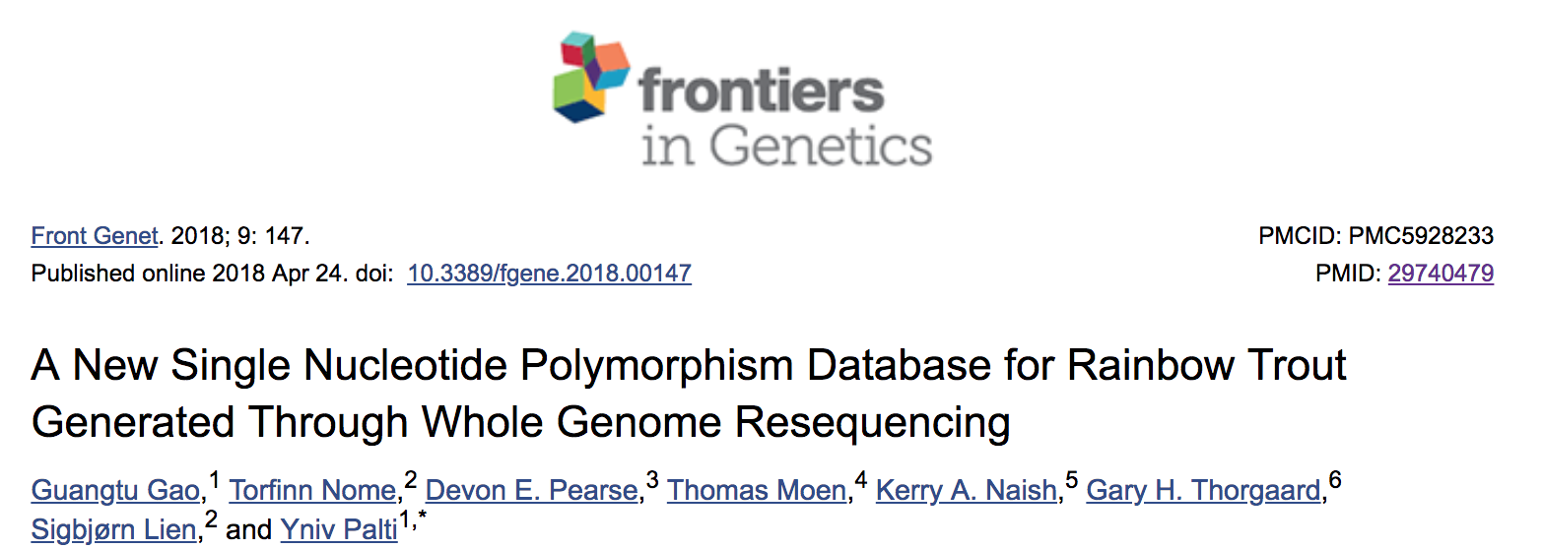
Example of variant calling and filtering with FreeBayes / samtools
SNP quality filter (QUAL): SNPs not located within 4 bases distance to an indel, and have the phred-scaled variant quality score, QUAL, larger than 30.
Low-complexity filter (LC): We removed the SNPs that are in the low-complexity regions as using mdust (https://github.com/lh3/mdust
Maximum depth filter (DP): maximum depth value of 1,500, corresponding to a coverage of 24.6 reads per sample
Minimum sample filter (NS): Only SNP sites with sequence reads coverage from at least 58 of the 61 samples passed this filter,
Double haploid filter (DH): Briefly, we filtered out SNP sites with heterozygous genotypes in at least two of the 11 DH lines that we re-sequenced in this study.

Slide 28
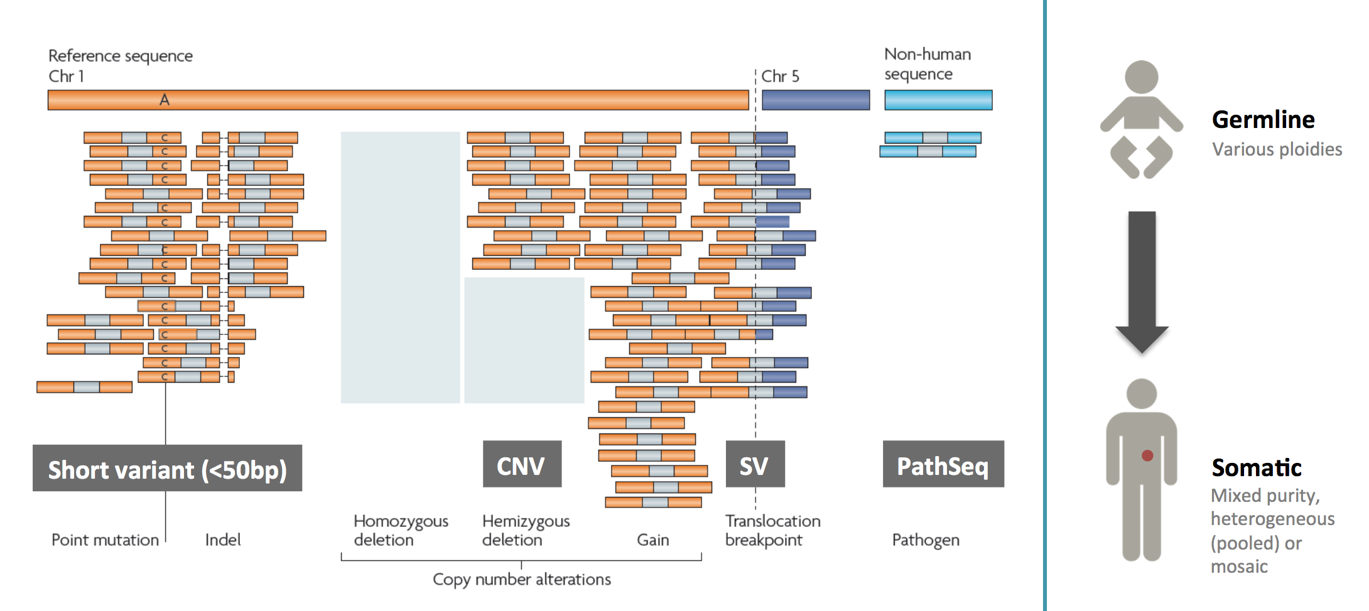
Additional consideration: germline vs somatic variants
Image source: GATK Broad Institute

Slide 29
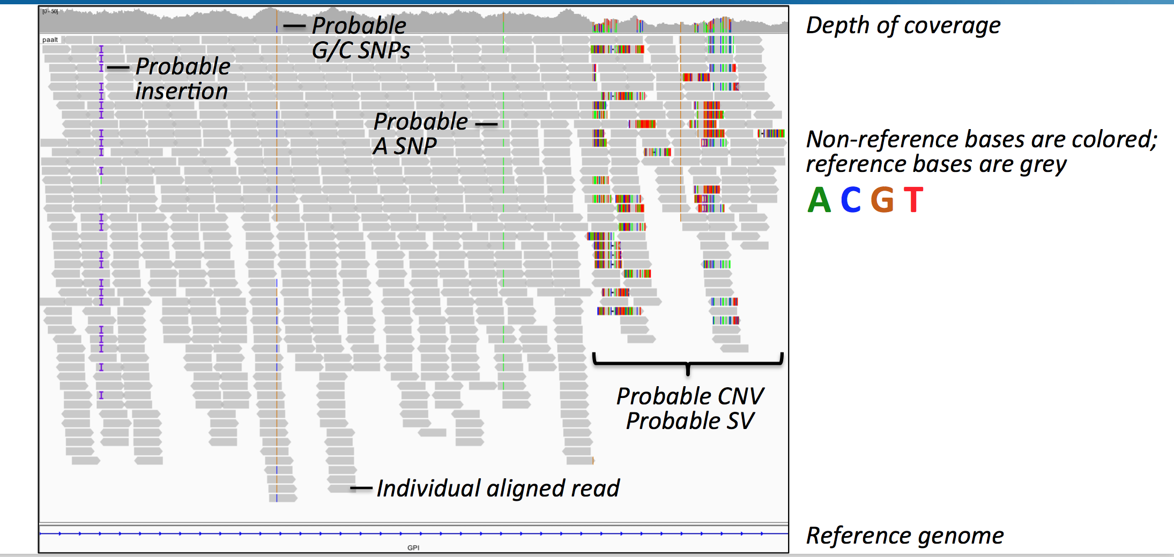
IGV browser: a must-have for variant inspection
Image source: GATK Broad Institute

Slide 30
Reference genome
There are different versions of human reference genome
Reference Name | Chr notation | Mitochondrial sequence | Additional sequences included
GRCh38 (Genome Reference Consortium) | 1, 2… X,Y,MT | Yes | Unlocalized Unplaced Alternate loci Centromere sequences
hg19 (UCSC genome browser) | Chr1, Chr2…ChrX, ChrY, ChrM | Copied from previous release | Unlocalized Unplaced Alternate loci
b37/b37+decoy/hs37d5 (1000GP) | 1, 2… X,Y,MT | Yes | Unlocalized Unplaced “decoy” sequence Human herpesvirus 4 type 1
Unlocalized: chromosome known, exact location unknown
Unplaced: known to originate from human genome, chromosome unknown
Alternate loci: alternate representation of specific human regions

Slide 31
Index files
Index files are needed for files in next-generation analysis, as file sizes are big!
Enables program to efficiently access the data, rather than having to read the whole file
File type | Index
FASTA | *fai
BAM | *bai
VCF | *vcf.idx

Slide 32
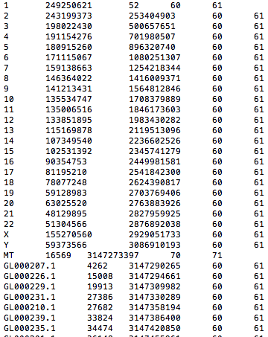
Reference FASTA index file

Slide 33
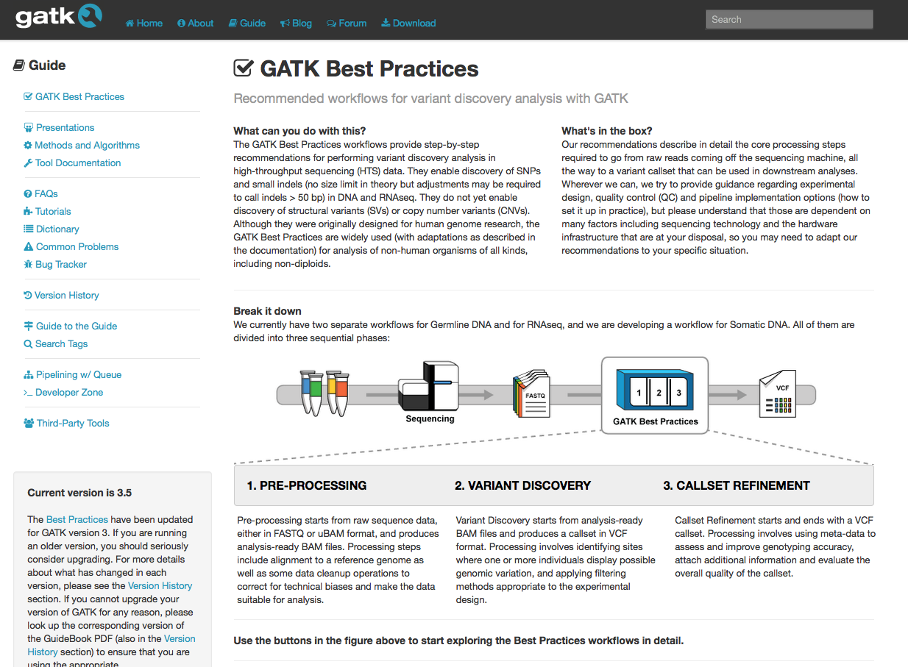
GATK Best Practices Website
https://www.broadinstitute.org/gatk/guide/best-practices

Slide 34
Why BWA+ GATK Haplotype caller?
Widely accepted as the “conventional” way of processing next-gen data
Well assessed
Well documented
Software is supported
Community support for troubleshooting or information

Slide 35
Data processing
Pre-processing
Variant discovery
Analysis
Align FASTQ to the reference genome (BWA-mem)
SAM/BAM file
Mark duplicates (PICARD)
Realign indels
(GATK IndelRealigner)
Sort mapped reads
Recalibrate base quality scores
(GATK BaseRecalibrator)
Generate genotype likelihoods for EVERY base, gVCFs
(GATK HaplotypeCaller)
Joint genotype, VCF
(GATK GenotypeGVCFs)
Recalibrate variants
(GATK VariantRecalibrator)
OR
apply hard filter (<30 samples)
Variant classification annotation (ANNOVAR)
Variant effect annotation
(ANNOVAR)
Filter variants to identify candidates of interest
Other options are:
VEP, GEMINI, SnpEff

Slide 36
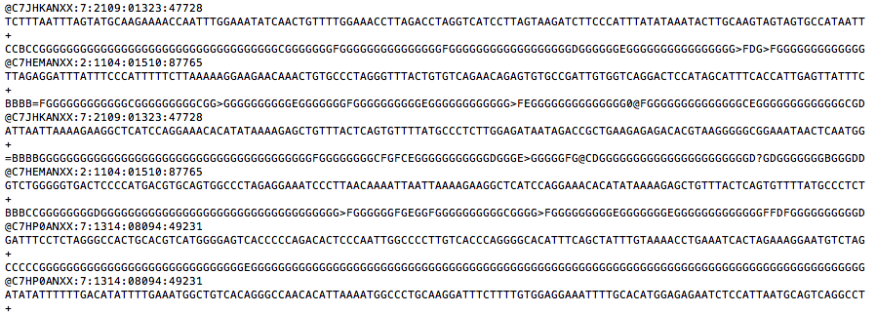
FASTQ
Pre-processing
Sequence ID
Sequence
Sequence quality
Align
BAM/SAM
Bitwise flags
position
CIGAR
Observed template length
Paired-end chr
Sequence ID
chrosome
MappingQ
Paired-end position
http://samtools.github.io/hts-specs/SAMv1.pdf

Slide 37
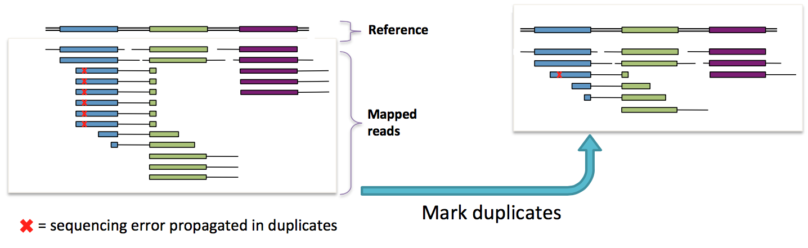
Marking duplicates and why is it necessary?
Pre-processing QC
Align FASTQ to the reference genome (BWA-mem)
SAM/BAM file
Mark duplicates (PICARD)
Realign indels
(GATK IndelRealigner)
Sort mapped reads
Recalibrate base quality scores
(GATK BaseRecalibrator)
It is assumed that each read corresponds to an independent DNA fragment from randomly sheared DNA
However, PCR amplification can cause duplicates
Identify based on start + stop of reads
Choose the best and ignore the rest
Broad Institute

Slide 38
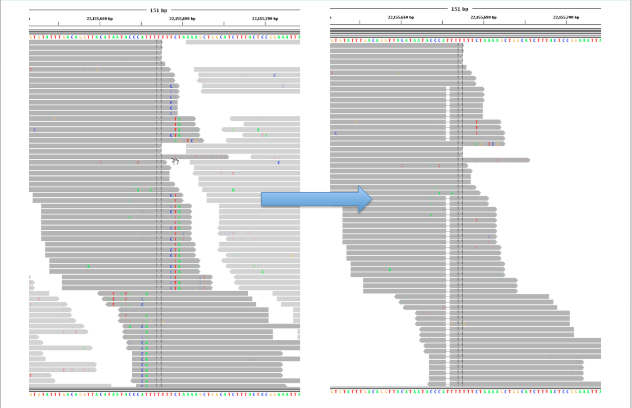
Indel realignment
Pre-processing QC
Misalignment around indels cause high number of SNPs
These regions are identified and locally realigned to minimize mismatches
Align FASTQ to the reference genome (BWA-mem)
SAM/BAM file
Mark duplicates (PICARD)
Realign indels
(GATK IndelRealigner)
Sort mapped reads
Recalibrate base quality scores
(GATK BaseRecalibrator)
Broad Institute
Notes:
-done in 2 steps
1)Determining (small) suspicious intervals which are likely in need of realignment (see the RealignerTargetCreator tool)
2)Running the realigner over those intervals (IndelRealigner)

Slide 39
Recalibrate Base Quality Scores
Pre-processing QC
Align FASTQ to the reference genome (BWA-mem)
SAM/BAM file
Mark duplicates (PICARD)
Realign indels
(GATK IndelRealigner)
Sort mapped reads
Recalibrate base quality scores
(GATK BaseRecalibrator)
Base scores are produced by sequencers
Quality scores are inaccurate and biased
Prone to various technical errors
QS are often over- or under estimated
To identify and correct non-random technical error
Physics or the chemistry of sequencing reactions
Manufacturing flaws in the equipment
Error covariates e.g.
Reported quality score
Position within the read (machine cycle)
Preceding and current nucleotide (sequencing chemistry)
Broad Institute

Slide 40
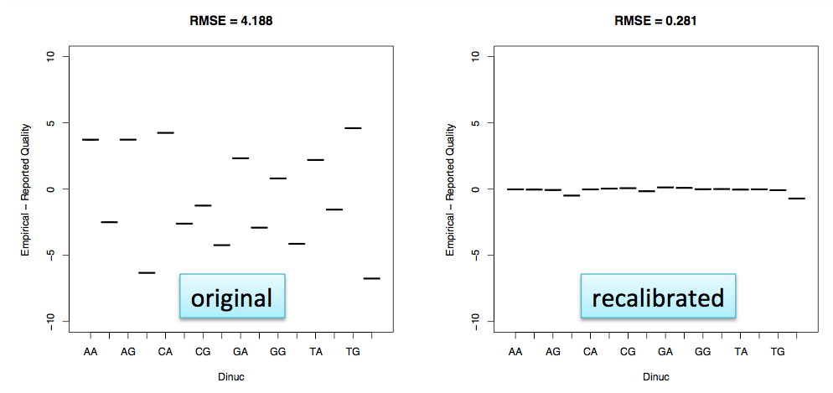
Recalibrate Base Quality Scores
Pre-processing QC
Align FASTQ to the reference genome (BWA-mem)
SAM/BAM file
Mark duplicates (PICARD)
Realign indels
(GATK IndelRealigner)
Sort mapped reads
Recalibrate base quality scores
(GATK BaseRecalibrator)
Over-estimation
Under-estimation
GATK BSQR builds model based on the known variants set
Adjusts the base quality scores in the data based on the model
Broad Institute
Notes:
Empirical quality based on known variants from publicly available databases

Slide 41
Now we are ready to call variants!

Slide 42
Variant Discovery
✔
Pre-processing
Variant discovery
Analysis
Align FASTQ to the reference genome (BWA-mem)
SAM/BAM file
Mark duplicates (PICARD)
Realign indels
(GATK IndelRealigner)
Sort mapped reads
Recalibrate base quality scores
(GATK BaseRecalibrator)
Generate genotype likelihoods for EVERY base, gVCFs
(GATK HaplotypeCaller)
Joint genotype, raw SNP & indel VCF
(GATK GenotypeGVCFs
Recalibrate variants
(GATK VariantRecalibrator)
OR
apply hard filter (<30 samples)
Variant classification annotation
(ANNOVAR)
Variant effect annotation
(ANNOVAR)
Filter variants to identify candidates of interest
Other options are:
VEP, GEMINI, SnpEff

Slide 43
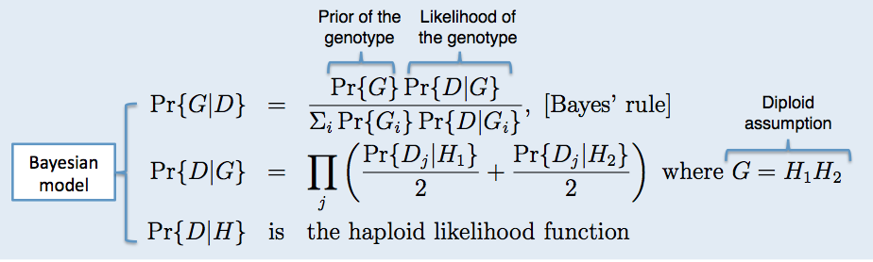
GATK uses a bayesian model
It determines possible SNP and indel alleles
Computes, for each sample, for each genotype, likelihoods of data given genotypes
Computes the allele frequency distribution to determine most likely allele count, and emit a variant call if determined
– When it reports a variant, it assign a genotype to each sample
http://www.broadinstitute.org/gatk//events/2038/GATKwh0-BP-5-Variant_calling.pdf

Slide 44
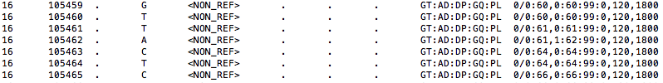
Generate genotype likelihoods in each sample (gVCF)
Variant Discovery
Generate genotype likelihoods for EVERY base, gVCFs
(GATK HaplotypeCaller)
Joint genotype, raw SNP & indel VCF
(GATK GenotypeGVCFs
Recalibrate variants
(GATK VariantRecalibrator)
OR
apply hard filter (<30 samples)
For a single sample, calculates normalized Phred-scaled likelihoods (PL) for genotypes:
“likelihood of the genotype”= “the probability that the genotype is not correct”
Normalized so that the most likely genotype is 0
Broad Institute

Slide 45
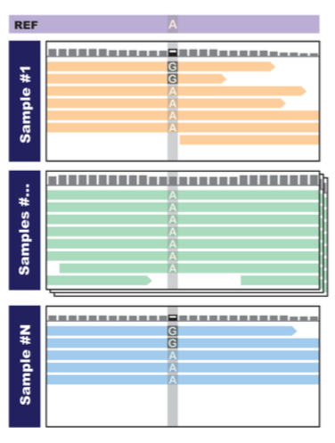
What is a joint genotyping?
Variant Discovery
If we analyze Sample 1 or Sample N alone, we are not confident that the variant is real
If we see both samples, we are more confident that there is real variation at this site in this cohort
Broad Institute
Notes:
This is especially useful for low-quality calls,
Identify false negatives because: 1) present as known variant in population, and 2) present among other individuals in cohort. Would have missed them otherwise because not the best quality.
Identify false positives because absent from population and cohort – remove because borderline quality. (If high quality, keep it – rare variants)

Slide 46
Generate new variant quality score using VQSR
Variant Discovery-QC
What is Variant Quality Score Recalibration
NOT adjusting scores!!
Generate new score VQSLOD (variant quality score log-odds)
Approach
Machine learning to profile good variants vs bad variants
Using multiple dimensions (5-8, typically)
Uses INFO annotations for each variant (eg. Allele count, allele frequency, etc)
Joint genotype, raw SNP & indel VCF
(GATK GenotypeGVCFs
Recalibrate variants
(GATK VariantRecalibrator)
OR
apply hard filter (<30 samples)
Generate genotype likelihoods for EVERY base, gVCFs
(GATK HaplotypeCaller)
Broad Institute

Slide 47
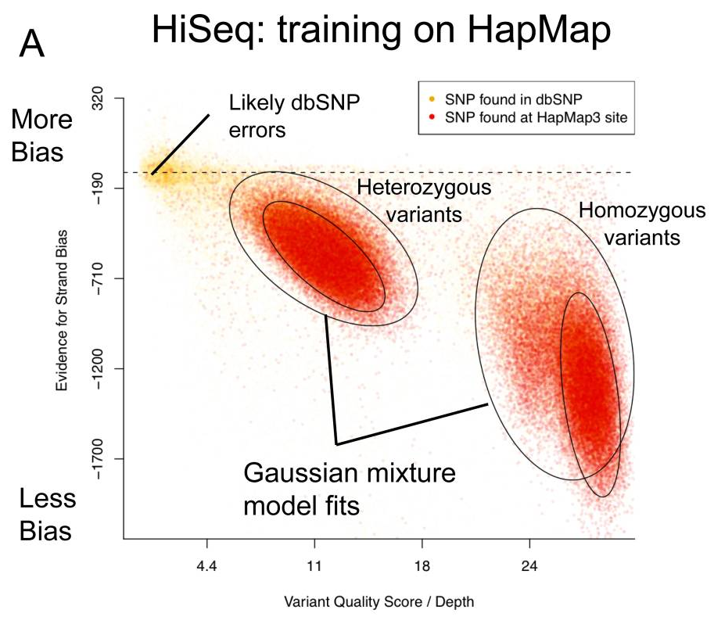
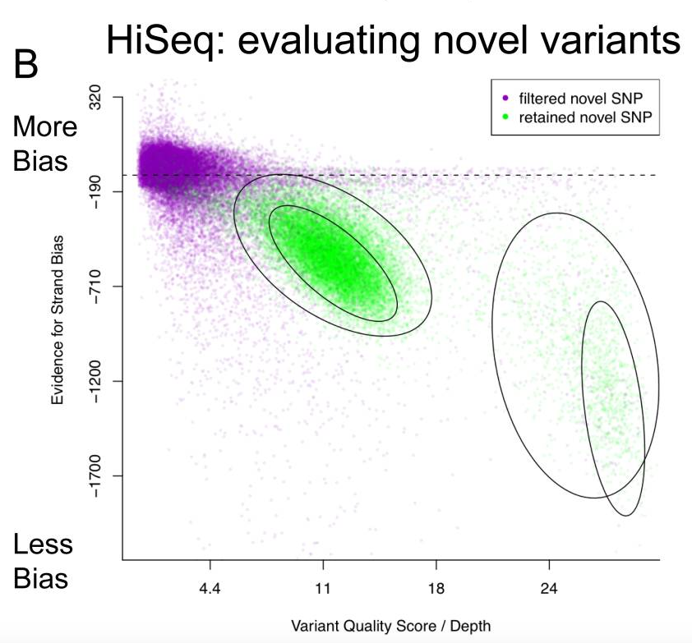
Generate new variant quality score using VQSR
Variant Discovery-QC
Joint genotype, raw SNP & indel VCF
(GATK GenotypeGVCFs
Recalibrate variants
(GATK VariantRecalibrator)
OR
apply hard filter (<30 samples)
Generate genotype likelihoods for EVERY base, gVCFs
(GATK HaplotypeCaller)
Toss
Keep
Train a model using “truth” set of known variants
Apply the model to your samples
http://gatkforums.broadinstitute.org/gatk/discussion/39/variant-quality-score-recalibration-vqsr

Slide 48
Alternatively! IF you have few samples use multiple filters
Variant Discovery-QC
Joint genotype, raw SNP & indel VCF
(GATK GenotypeGVCFs
Recalibrate variants
(GATK VariantRecalibrator)
OR
apply hard filter (<30 samples)
Generate genotype likelihoods for EVERY base, gVCFs
(GATK HaplotypeCaller)
Apply hard filter!
Define how to filter your variant or use default filter parameters
QualByDepth (QD) 2.0
FisherStrand (FS) 60.0
RMSMappingQuality (MQ) 40.0
MappingQualityRankSumTest (MQRankSum) -12.5
ReadPosRankSumTest (ReadPosRankSum) -8.0 (only het calls)
http://gatkforums.broadinstitute.org/gatk/discussion/39/variant-quality-score-recalibration-vqsr
Notes:
QualByDepth (QD) 2.0: This is the variant confidence (from the QUAL field) divided by the unfiltered depth of non-reference samples.
FisherStrand (FS) 60.0 :Phred-scaled p-value using Fisher’s Exact Test to detect strand bias (the variation being seen on only the forward or only the reverse strand) in the reads. More bias is indicative of false positive calls.
RMSMappingQuality (MQ) 40.0 :This is the Root Mean Square of the mapping quality of the reads across all samples.
MappingQualityRankSumTest (MQRankSum) -12.5 :This is the u-based z-approximation from the Mann-Whitney Rank Sum Test for mapping qualities (reads with ref bases vs. those with the alternate allele). Note that the mapping quality rank sum test can not be calculated for sites without a mixture of reads showing both the reference and alternate alleles, i.e. this will only be applied to heterozygous calls.
ReadPosRankSumTest (ReadPosRankSum) -8.0: This is the u-based z-approximation from the Mann-Whitney Rank Sum Test for the distance from the end of the read for reads with the alternate allele. If the alternate allele is only seen near the ends of reads, this is indicative of error. Note that the read position rank sum test can not be calculated for sites without a mixture of reads showing both the reference and alternate alleles, i.e. this will only be applied to heterozygous calls.

Slide 49
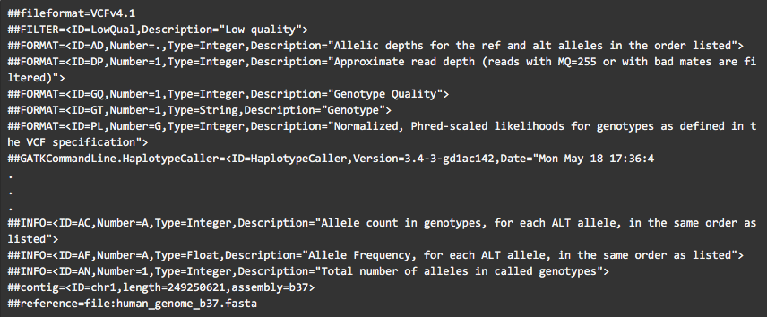
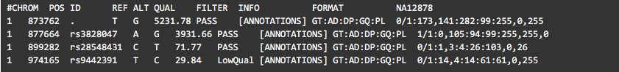
Final VCF
Variant Discovery-Final VCF
Header
Body

Slide 50
Overview of next-generation sequencing processing for variant analysis
Sequence
Align reads/mapping
Variant calling
Annotate
Downstream analysis
Quality control

Slide 51
Annotating Variants
Variant Annotation
Variant classification annotation
(e.g. ANNOVAR, SnpEff or GEMINI)
Variant effect annotation
Filter variants to identify candidates of interest
Gene Annotation | refSeq Gene, mitochondrial variants, USC/EnSembl, GENCODE/CCDS
Region-based Annotation | Conserved genomic elements, transcription factor binding site, cytogenetic band, segmental duplications, GWAS..
Filter-based annotation | 1000 GP, dbSNP, ESP, EXAC, non-synonymous variants annotation (SIFT/Polyphen2/MutationTaster/LRT/FATHMM/CADD..), ClinVar…
For comprehensive list, see http://annovar.openbioinformatics.org/en/latest/

Slide 52
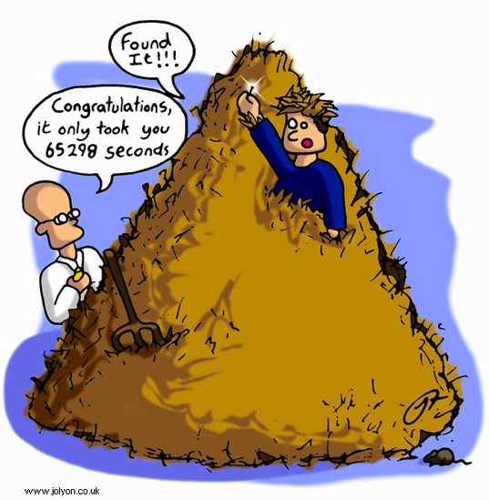
Variant Analysis… like finding a needle in a ‘deep’ haystack

Slide 53

Look for evidence of variants of interest

Slide 54
Further filters needed
High number of variants
The goal is to narrow down your list of variants
Eliminate variants that are not interesting
17,687 SNPs
1000 genomes
dbSNPs
In house exome
2 novel in chr10
PLoS One. 2012;7(1):e29708

Slide 55
Things to consider
Filter based on
Population frequency/Novel-variants
synonymous vs non-synonymous
Exonic vs intronic
Genes of interest/understand the gene
Clinically-relevant genes (OMIM, HGMD)
Predictions (quality of variants, deleteriousness)
Study phenotype (literature search)
Filter variants to identify candidates of interest
Notes:
-if you have family data or case/control, you can further eliminate variants

Slide 56
Overview of next-generation sequencing processing for variant analysis
Sequence
Align reads/mapping
Variant calling
Annotate
Downstream analysis
Quality control

Slide 57
Additional Analysis
Trio/Family Based Analysis
PhaseByTransmission (GATK)
GEMINI https://gemini.readthedocs.org/en/latest/
pVAAST
Somatic Variation
Tumor/normal
MuTech http://archive.broadinstitute.org/cancer/cga/mutect
Association Studies
Copy number variation analysis

Slide 58
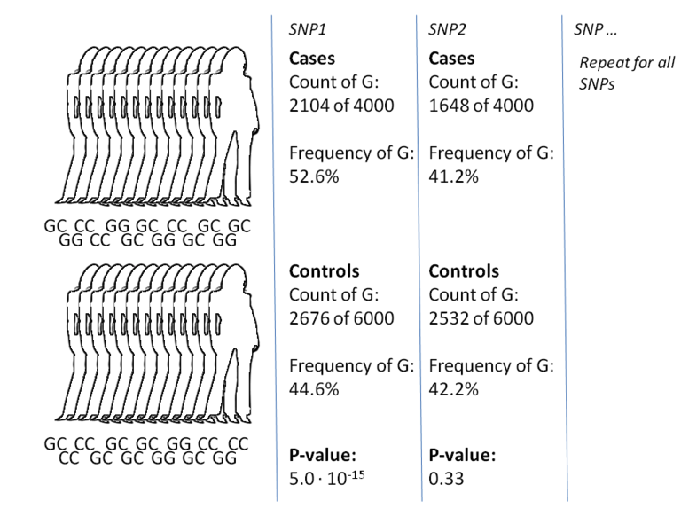
GWAS Association studies
A typical analysis:
Identify SNPs where one allele is significantly more common in cases than controls
Hardy-Weinberg Chi Square
http://en.wikipedia.org/wiki/Genome-wide_association_study
http://www.ebi.ac.uk/gwas/
Notes:
Exclude SNPs in Hardy-Weinberg disequilibrium

Slide 59
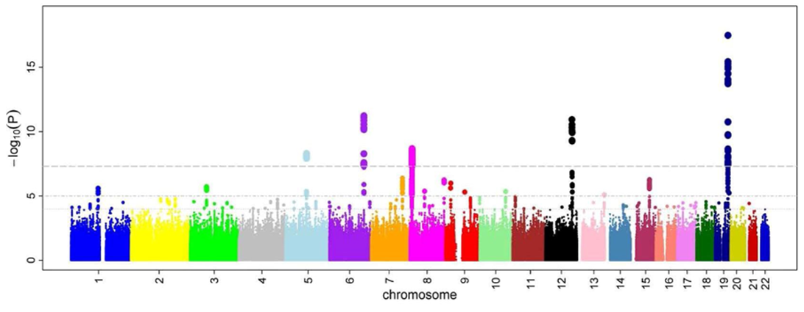
GWAS manhattan plot
Only applicable for large cohort

Slide 60
CNVs from exome
High variability of read-depth in exomes
CNV prediction is very challenging problem
High false positives
Break-points limited due to targets
Long range CNVs have higher positive predictive value
Useful when other alternatives (SNPs or aCGH) are not available
Lots of prediction tools!! (some examples below)
Population Caller | Somatic Caller
XHMM CoNIFER EXCAVATOR ExomeDepth CONTRA | ADTEx ExomeCNV Varscan2 Control-FREEC

Slide 61
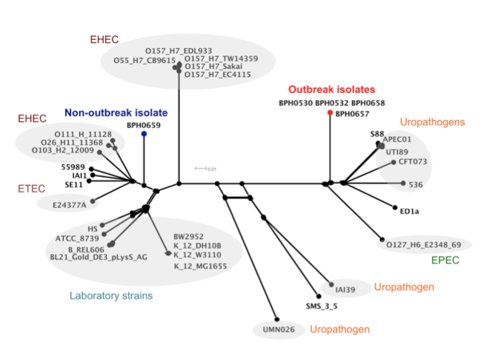
Deep Sequence: Fast genotyping
Outbreak investigation using high-throughput genome sequencing within a diagnostic microbiology laboratory.
J Clin Microbiol. 2013 Feb 13
Ion Torrent was used!
Notes:
Abstract
Next-generation bacterial genome sequencing (NGS) has become more accessible and is now potentially available to the routine diagnostic microbiology laboratory. However questions remain regarding feasibility, particularly with respect to data analysis in non-specialist centres. To test the applicability of NGS for outbreak investigation, Ion Torrent sequencing was used to investigate a putative multi-drug resistant E. coli outbreak in a neonatal unit. Four suspected outbreak strains and a comparator strain were sequenced. Genome-wide single nucleotide polymorphism (SNP) analysis demonstrated the four NICU strains were identical, and easily differentiated from the comparator strain. Genome sequence data also determined the NICU strains were multilocus sequence type 131, and carried the bla(CTX-M-15) extended-spectrum beta-lactamase. Comparison of the outbreak strains to all publicly available complete E. coli genome sequences showed that they clustered with neonatal meningitis and uropathogenic isolates. The turnaround time from positive culture to completion of sequencing (prior to data analysis) was five days, at a cost of approximately US$300 per strain (reagents only). The main obstacles to mainstream adoption of NGS technologies in diagnostic microbiology laboratories are currently cost (although this is decreasing), a paucity of user-friendly and clinically-focussed bioinformatics platforms, and genomics expertise outside the research environment. Despite these hurdles, NGS technologies provide unparalleled high-resolution genotyping in a short time frame, and are likely to be widely implemented in diagnostic microbiology in the next few years, particularly for epidemiological investigations (replacing current typing methods) and characterising resistance determinants. Clinical microbiologists need to familiarise themselves with these technologies and their applications.

Slide 62
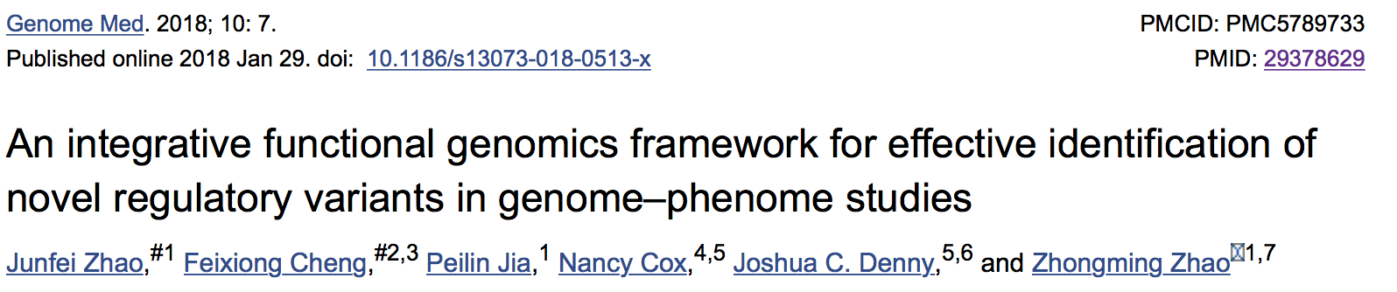
A more integrative approach
A brain-specific TF-target gene regulatory network for AD
The TF-target gene network was generated by mapping the significant SNPs with AD from the PheWAS Catalog into the enhancer or promoter regions via three components: (1) genome-wide mapping of promoters and enhancers; (2) linking TFs to promoters and enhancers; and (3) linking enhancers and promoters to target genes
Notes:
A brain-specific TF-target gene regulatory network for AD. The TF-target gene network was generated by mapping the significant SNPs with AD from the PheWAS Catalog into the enhancer or promoter regions via three components: (1) genome-wide mapping of promoters and enhancers; (2) linking TFs to promoters and enhancers; and (3) linking enhancers and promoters to target genes as described in “Methods.” TFs are denoted by Vee and target genes with significant SNPs are denoted by circles. The node color is coded based on the brain-specific gene expression quantified by z-scores using the RNA-sequencing (RNA-seq) data from GTEx (see “Methods”). A larger z-score indicates a higher expression level in brain compared to other tissues. Green lines represent the enhancer-gene regulations and orange lines represent the promoter-gene regulations. Several TFs and targeted genes (e.g. ZIC1, STX1B, CDH13, and SKA2) described in the main text are highlighted. Both Figs. 5 and ​and66 were prepared using Cytoscape (v2.8.1)

Slide 63
Let’s practice

